Slide 1

Risk Analytics in Banking
Ali M. Mostafa

Slide 2

Dataset Description
Question?
The data contains the information about the loan application at the time of applying for the loan.
When a client applies for a loan, there are four types of decisions that could be taken by the bank:
Approved
Cancelled
approval.
Refused
Unused offer
Is the applicant eligible for the loan?

Slide 3
Problem
When a Bank receives a loan application, it must decide on the loan's approval based on the applicant's profile. The bank is faced with two types of risks:
1- If the applicant is likely to repay the loan, then not approving it results in the bank losing business.
2- If the applicant is not likely to repay the loan, then approving it results the loan may lead to a financial loss.

Slide 4
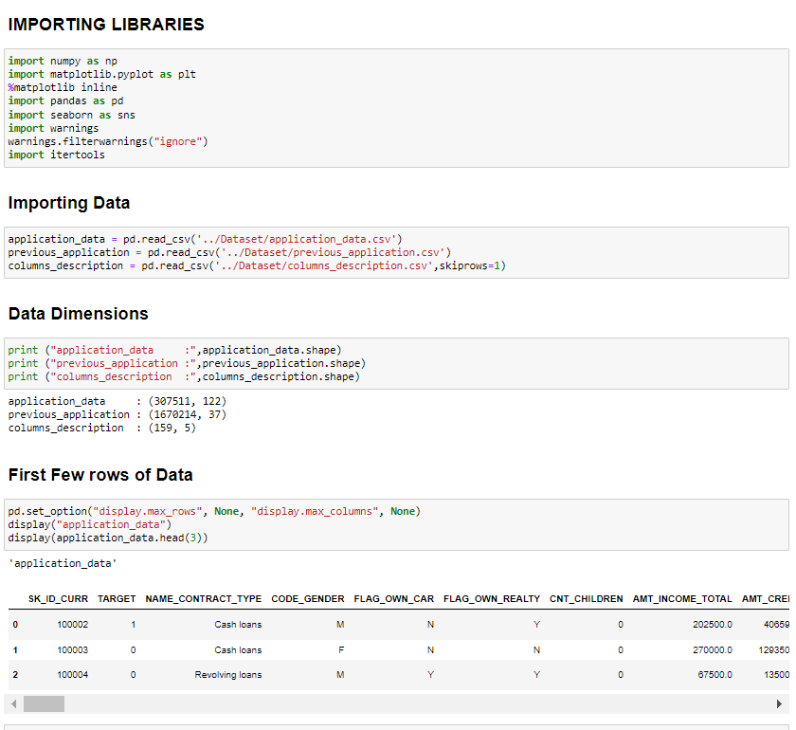
Import Libraries

Slide 5
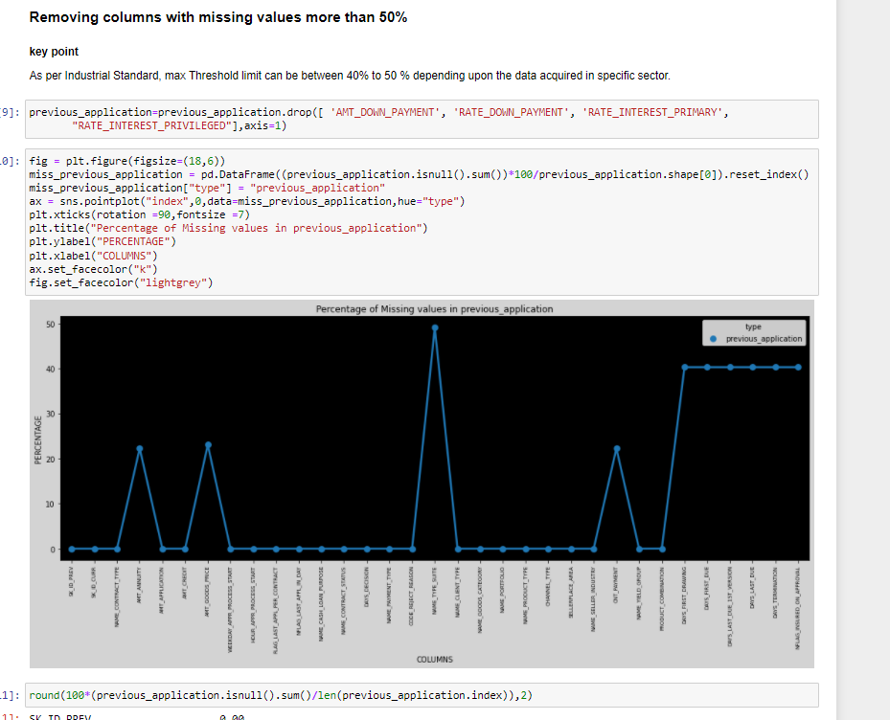
Removing columns with missing value > 50%

Slide 6
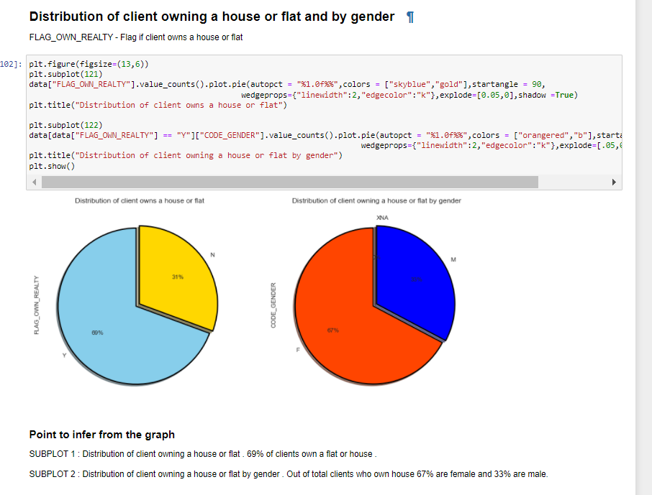

Slide 7
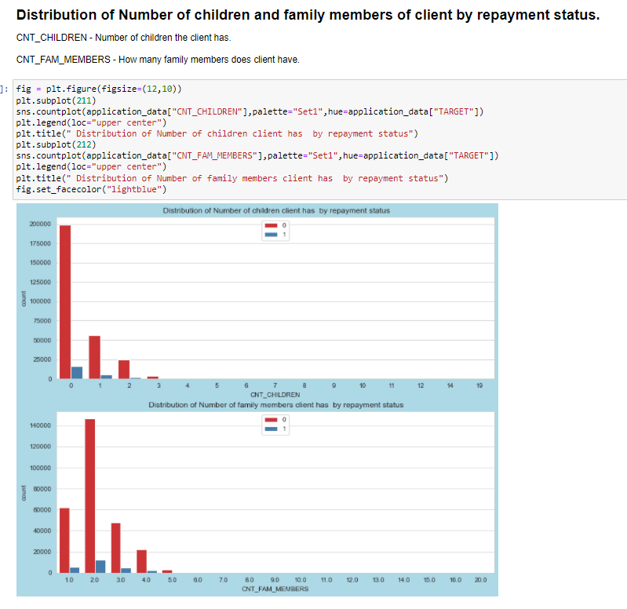

Slide 8
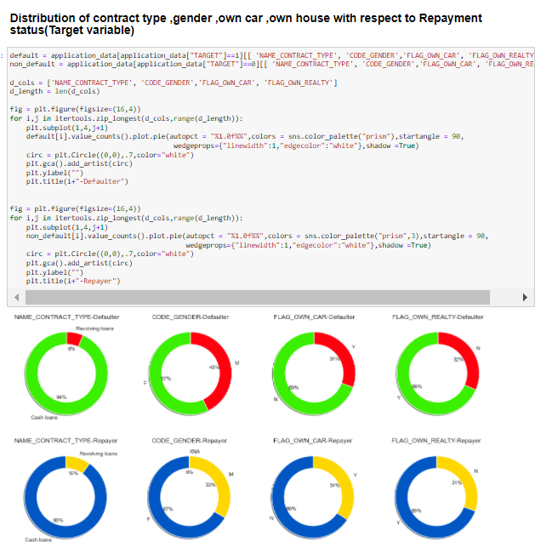

Slide 9
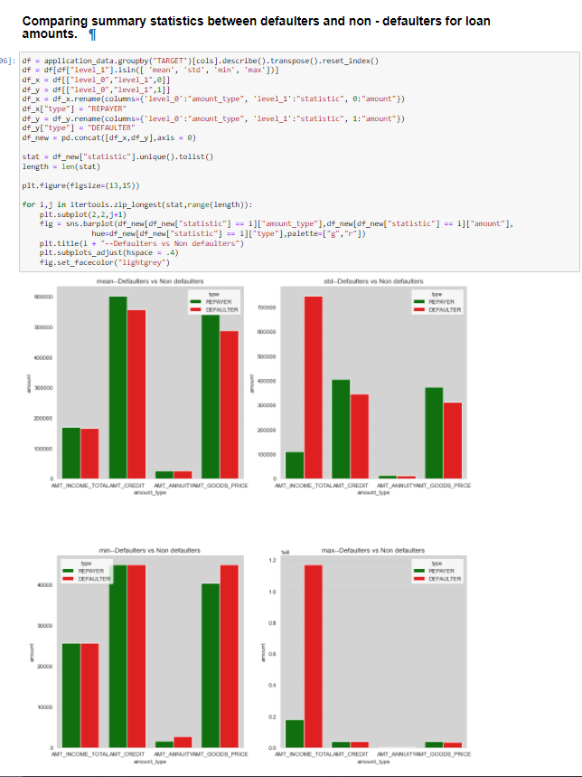

Slide 10
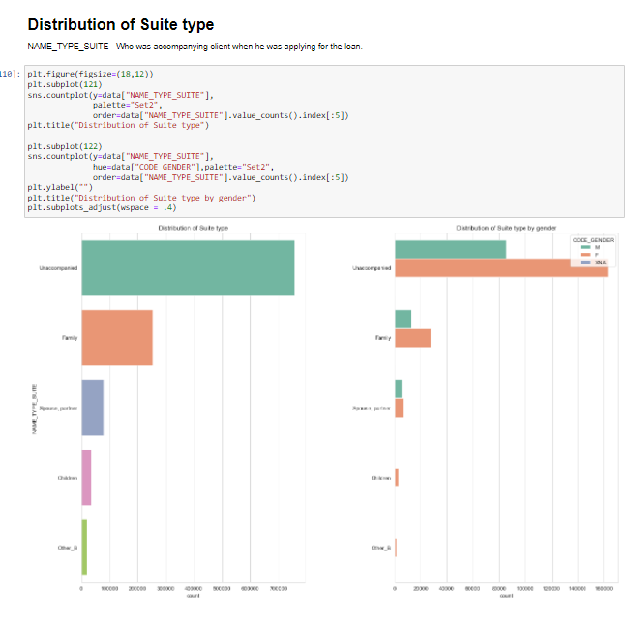

Slide 11
Thanks

